Slide 1
Gemini: A Non-Invasive, Energy-Harvesting True Power Meter
Brad Campbell and Prabal Dutta
University of Michigan
RTSS’14 – December 5, 2014

Slide 2
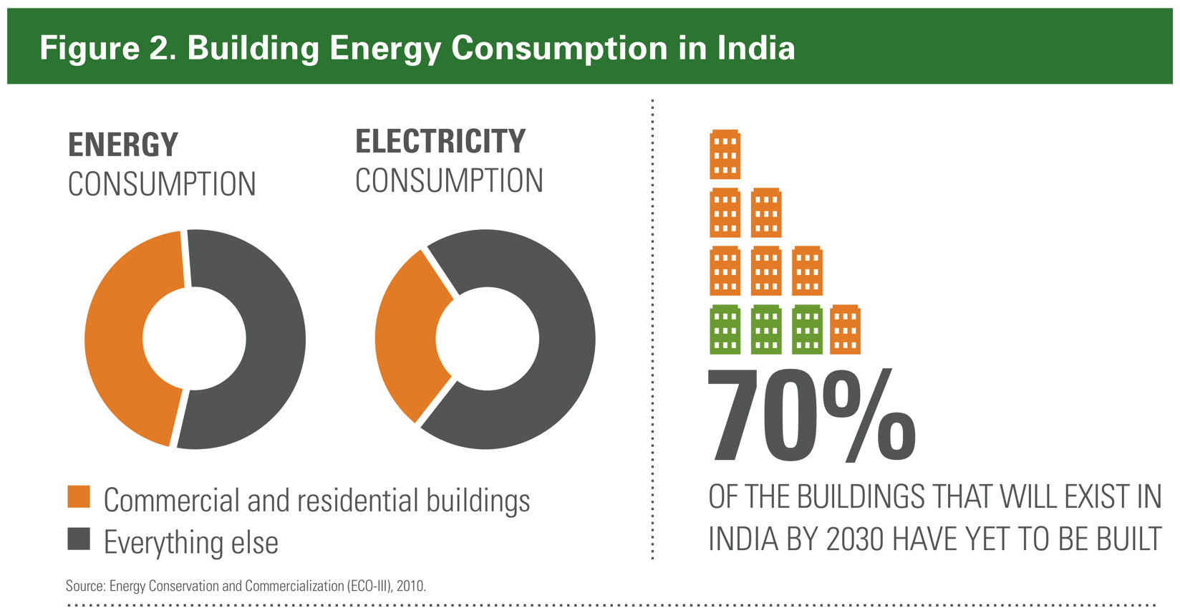
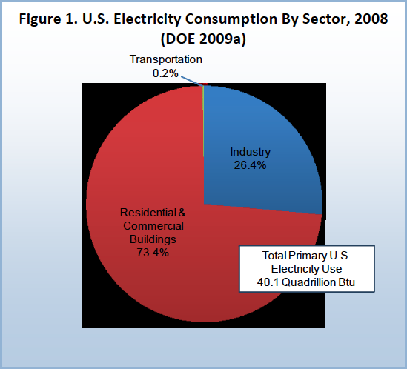
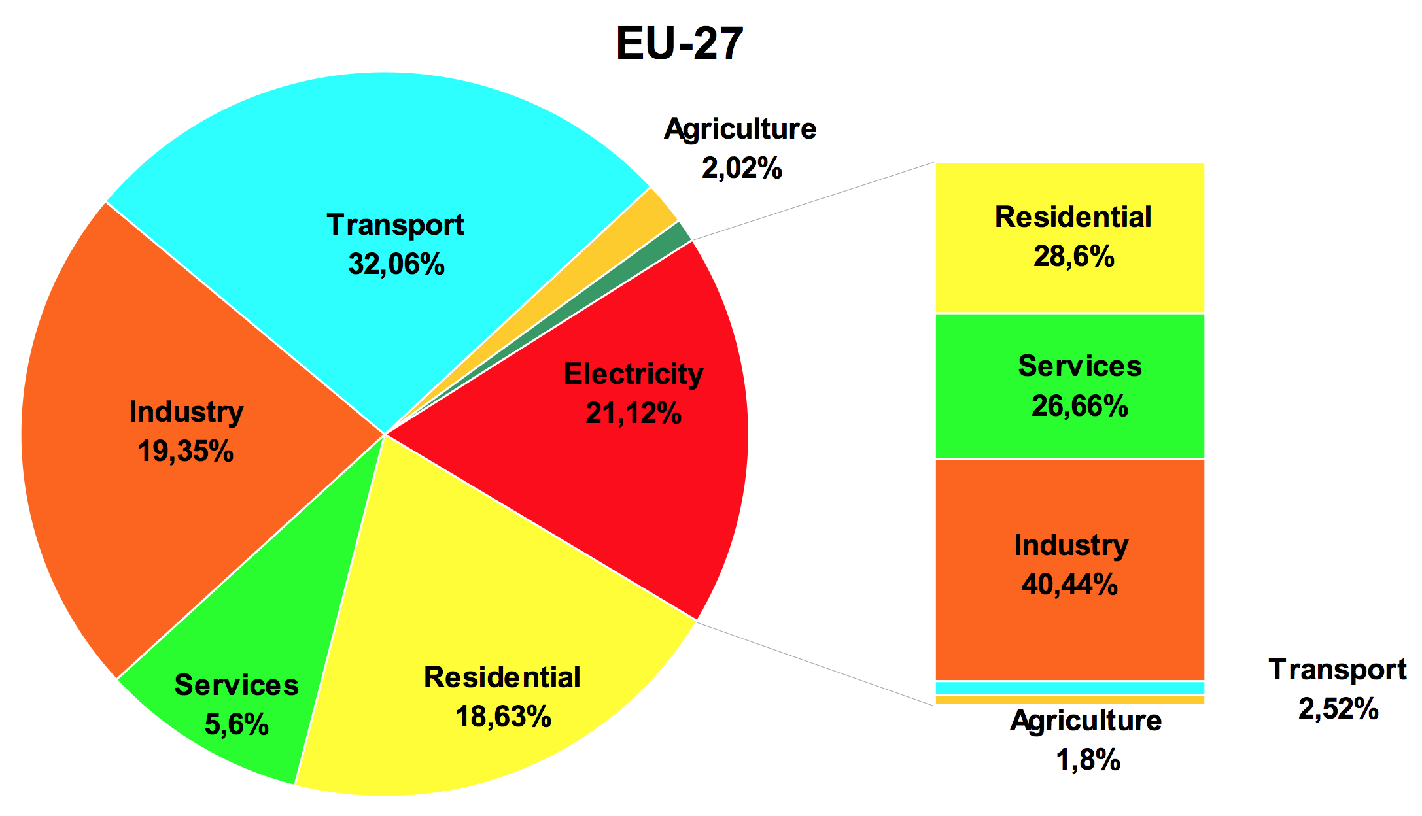
Buildings are significant consumers of electricity worldwide
55.3%
Source: Natural Resources Defense Council, “Constructing Change: Accelerating Energy Efficiency in India’s Buildings Market”
Source: NIST, “Measurement Science Roadmap for Zero-Net Energy Buildings”
Source: JRC, “Electricity Consumption and Efficiency Trends in European Union”

Slide 3
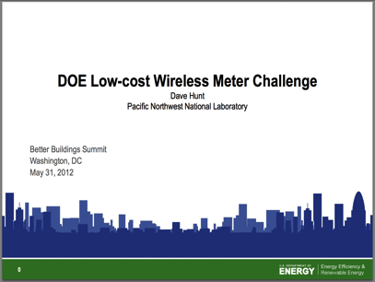


But we don’t know where the electricity goes inside of the building
“However, sub-metered energy use data are not available for many buildings, often due to the high cost of metering and gathering data.”
US Department of Energy Building Technologies Office
“Technological areas requiring further development include sensing and measurement technologies.”
US National Science Board August 2009
“To properly direct [building efficiency] efforts, planners must understand where energy…is consumed.”
US National Science and Technology Council Committee on Technology, Oct 2011
Notes:
Make two slides

Slide 4
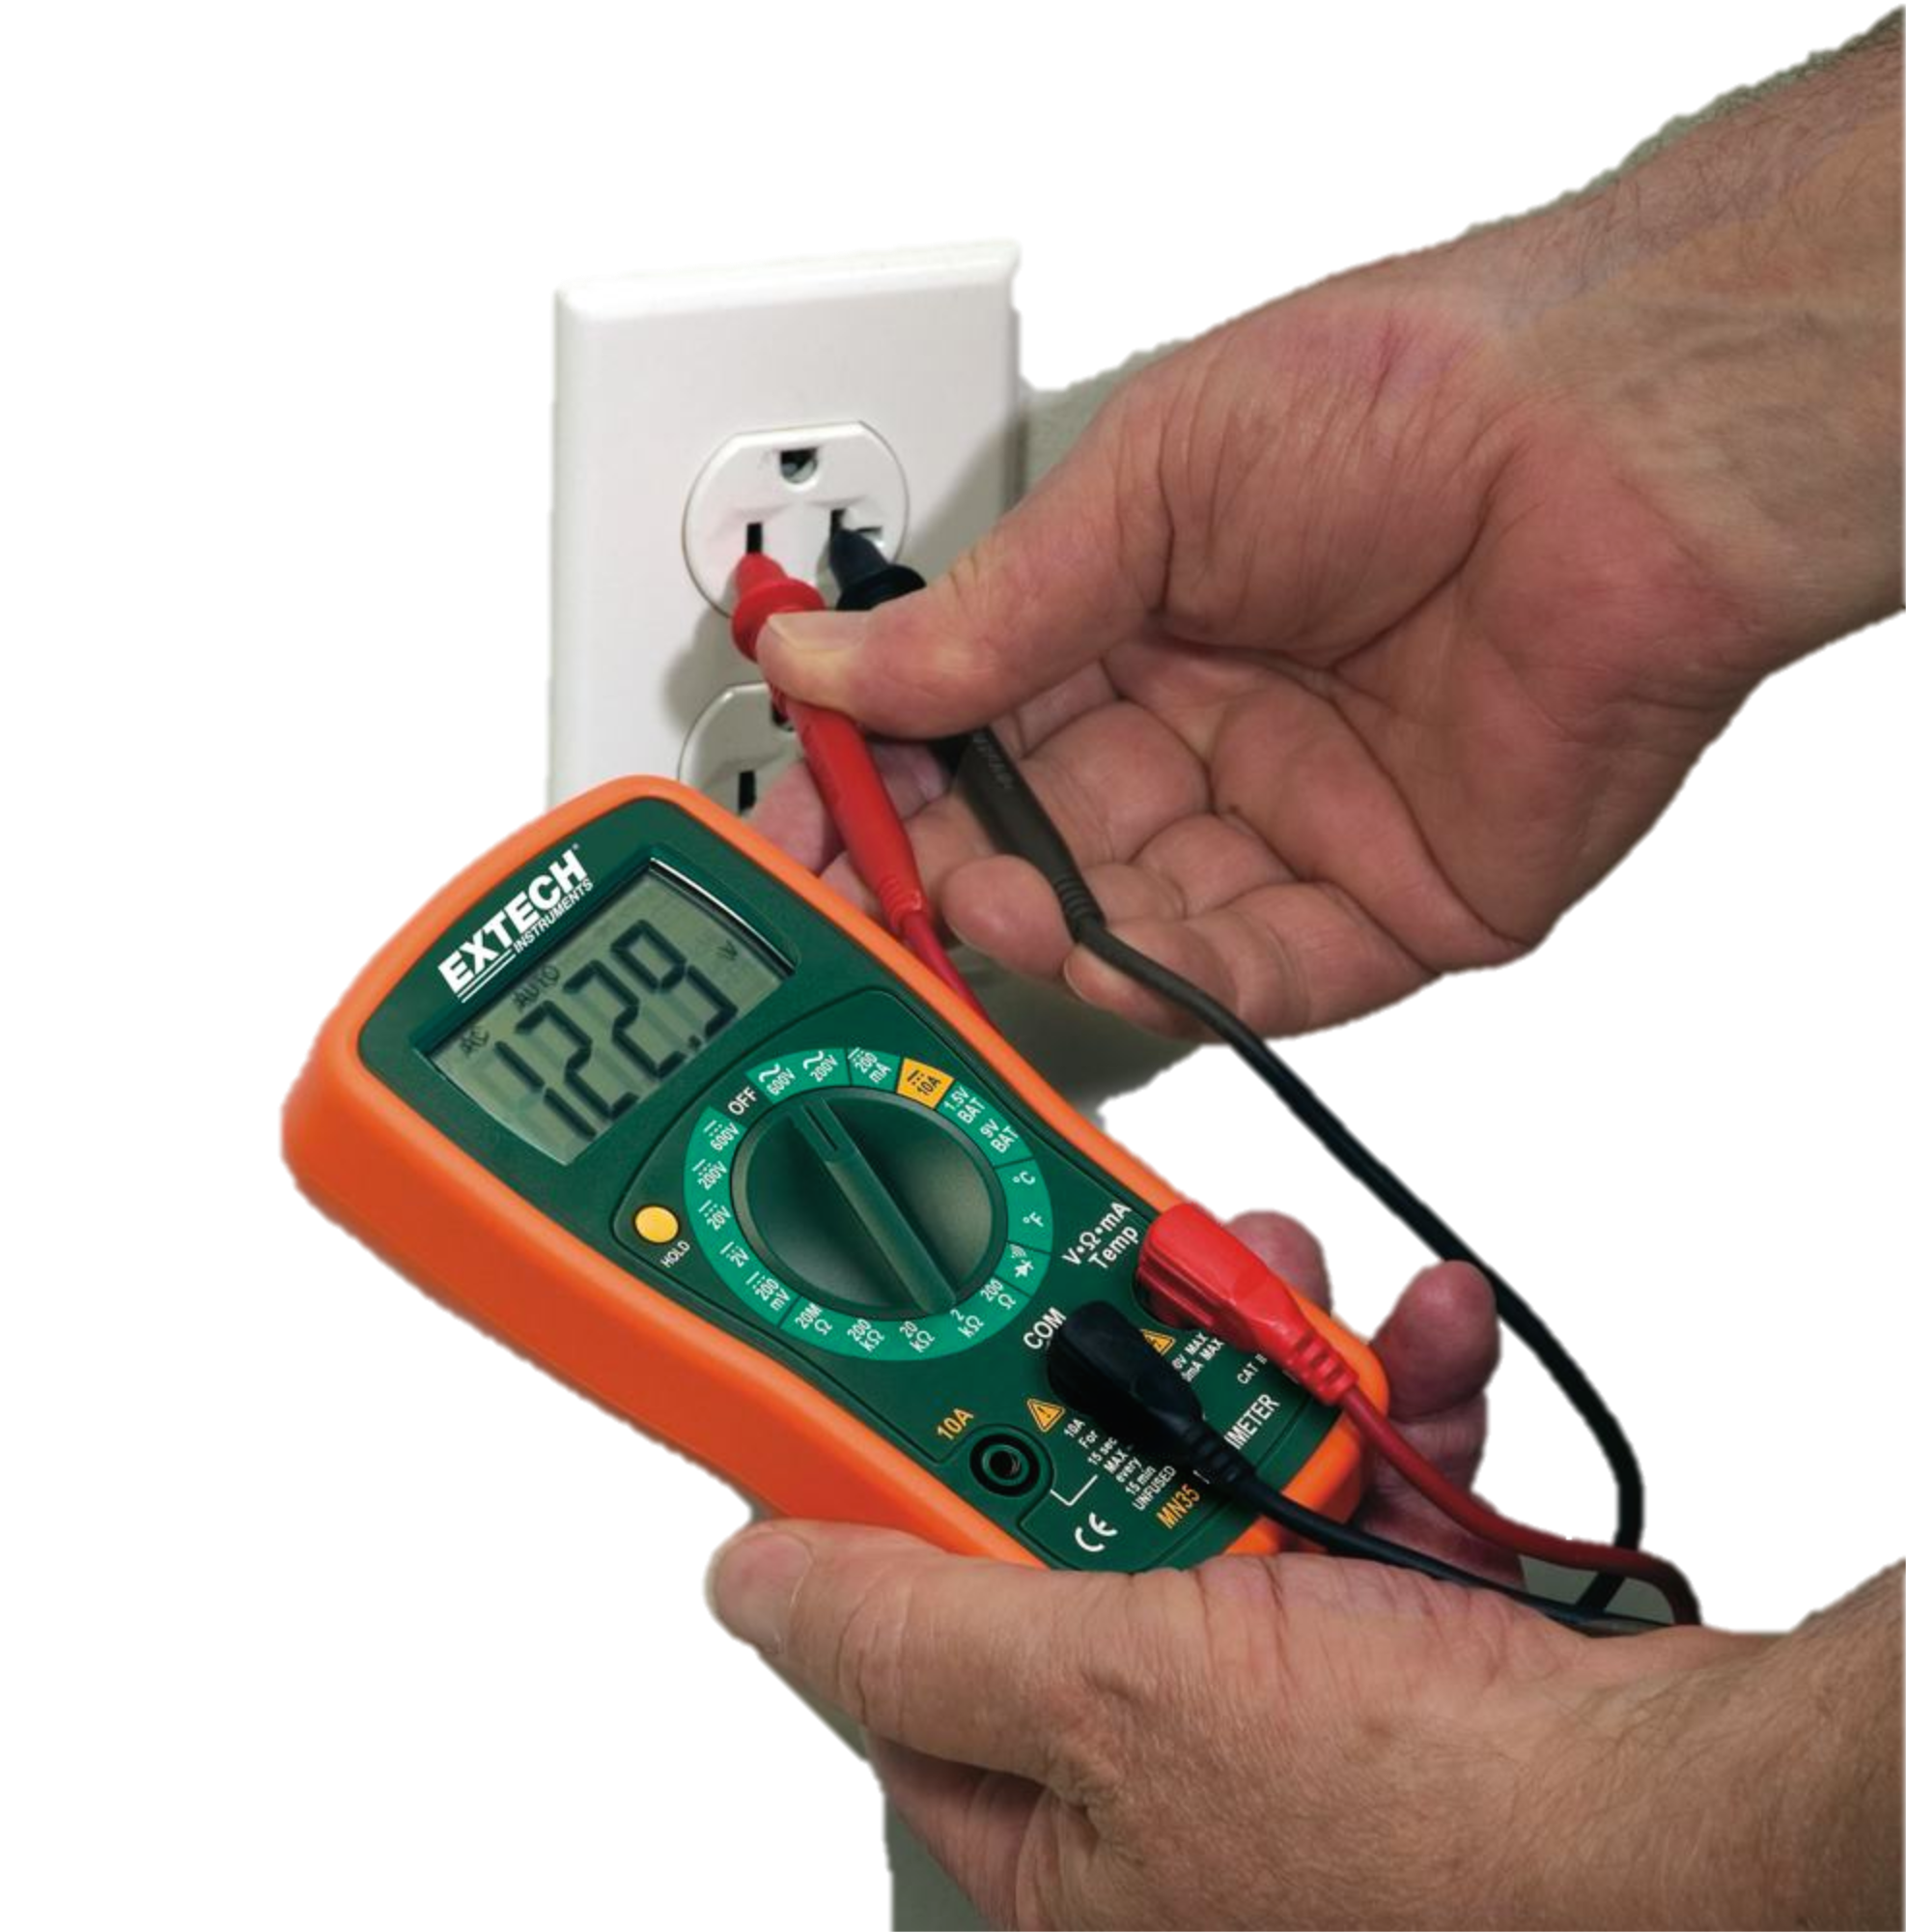
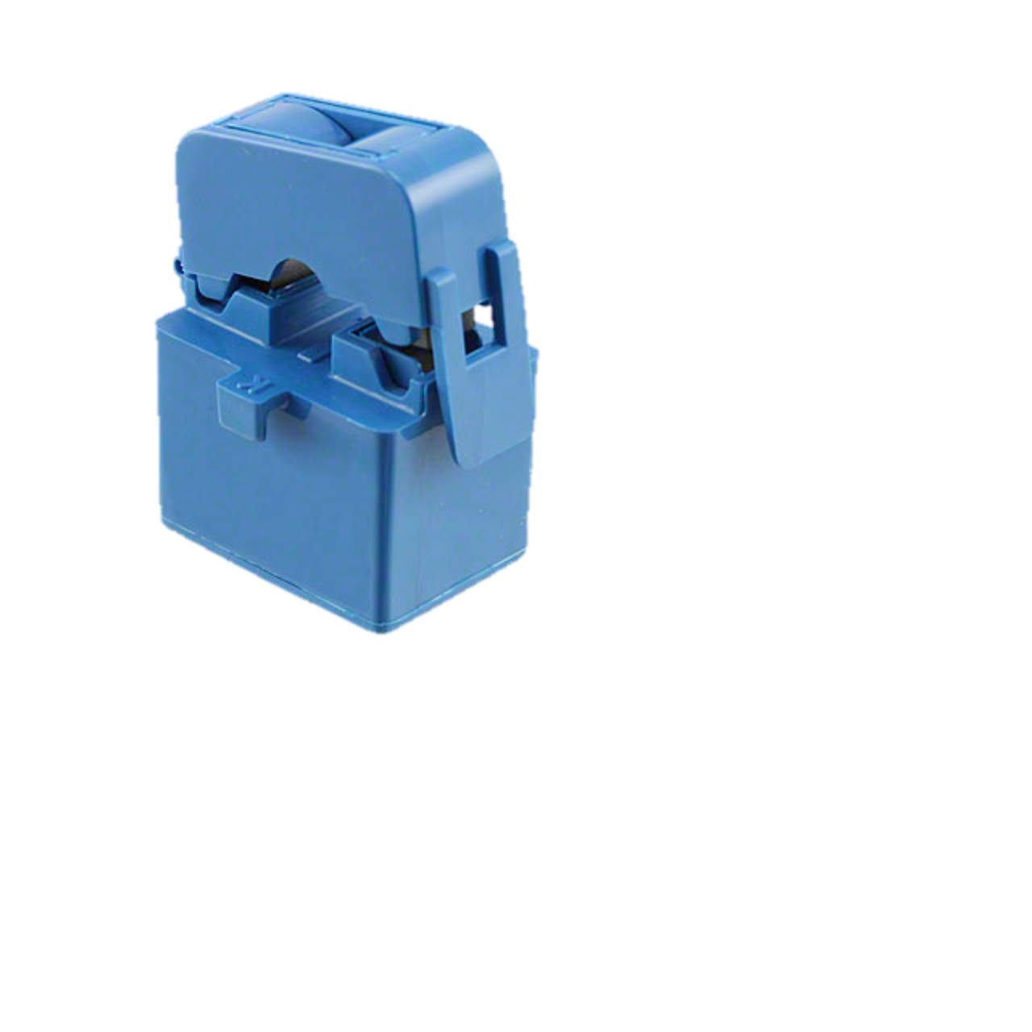
Gemini: A true power meter to address this issue
Circuit panel level energy-harvesting meter that measures true power
Voltage Monitor
Current Meter
Two devices work together to calculate power

Slide 5

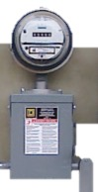

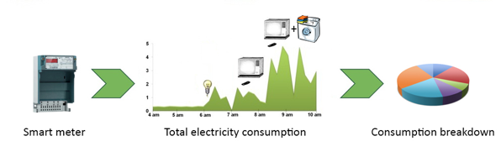
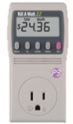
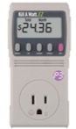
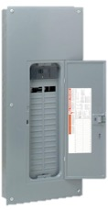
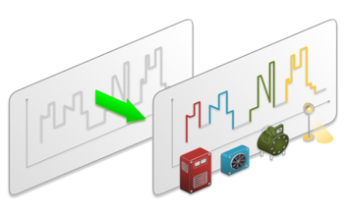
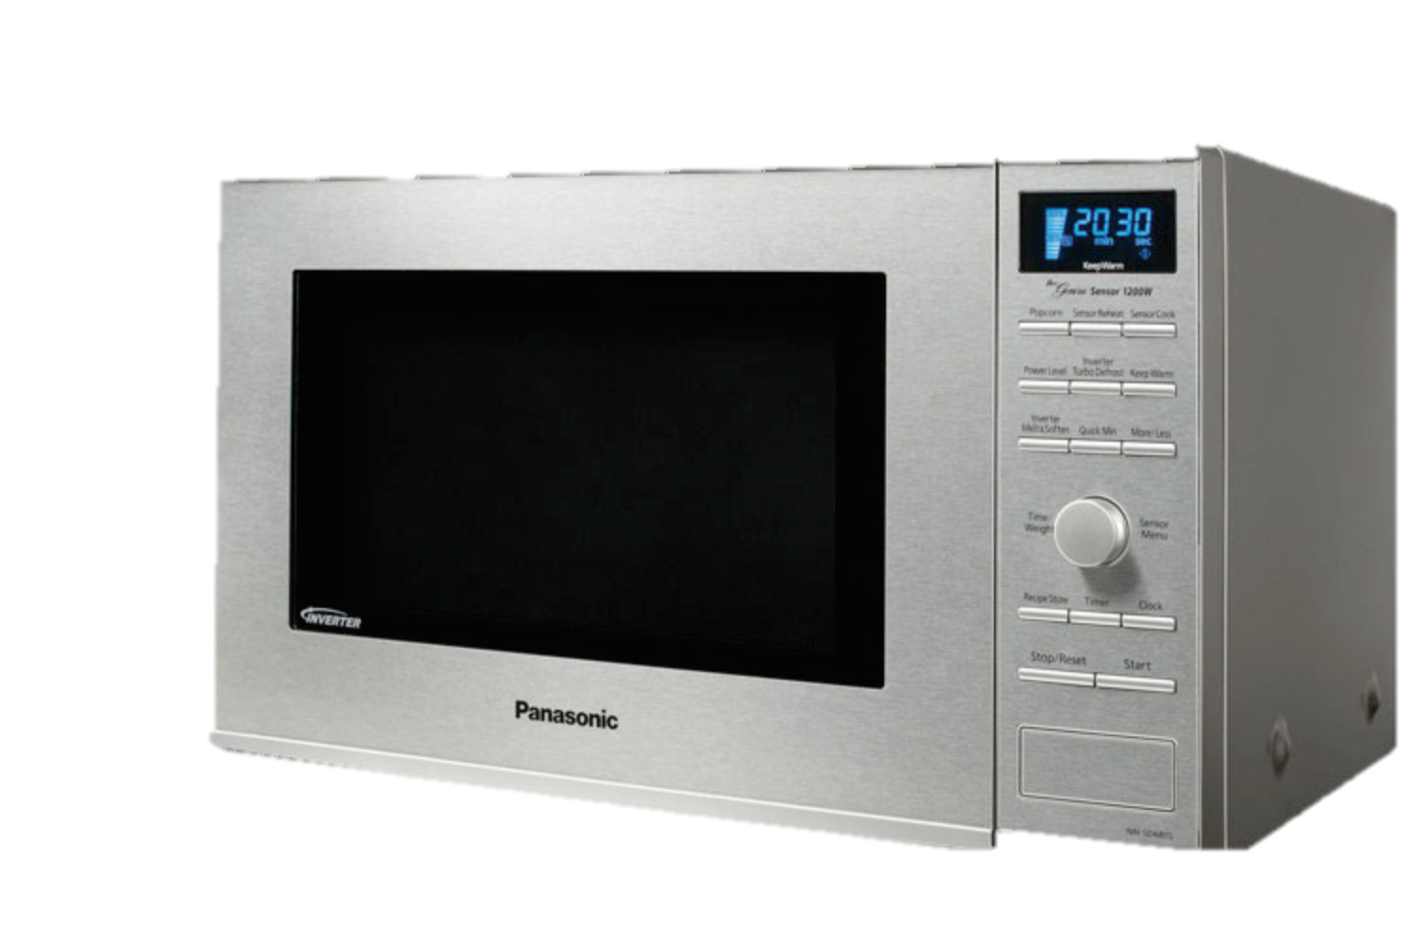

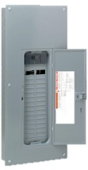

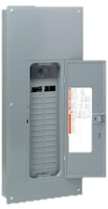

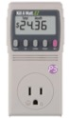
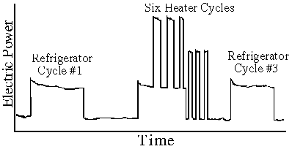

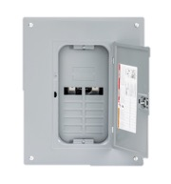

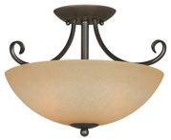
How can we determine the electricity breakdown?
Meter every device
Meter at the circuit level
Single watch point solutions
?
High installation cost
Configuration
Defined sense points
Reasonable load fidelity
Extensive calibration
Scale issues

Slide 6
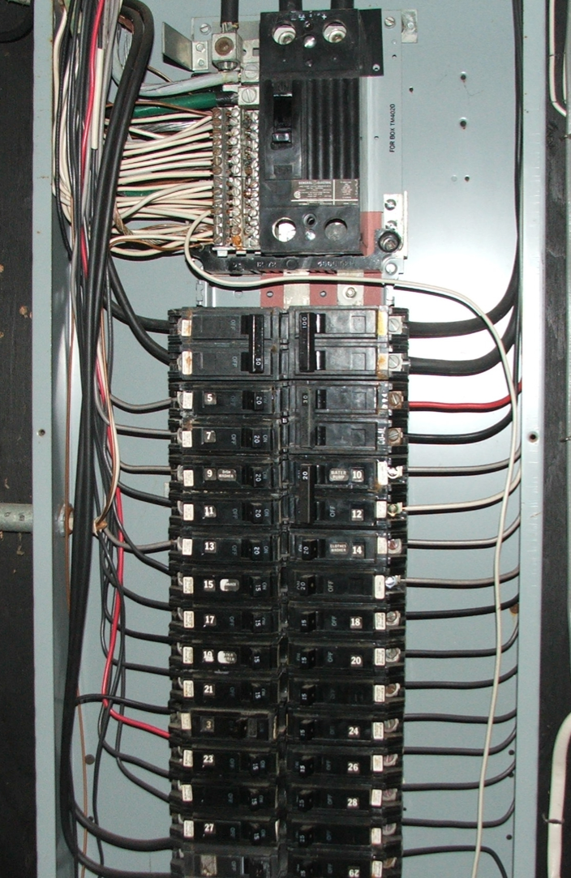
End goal: Measure true power P(t)=I(t)*V(t)
Voltage
Current
Power

Slide 7
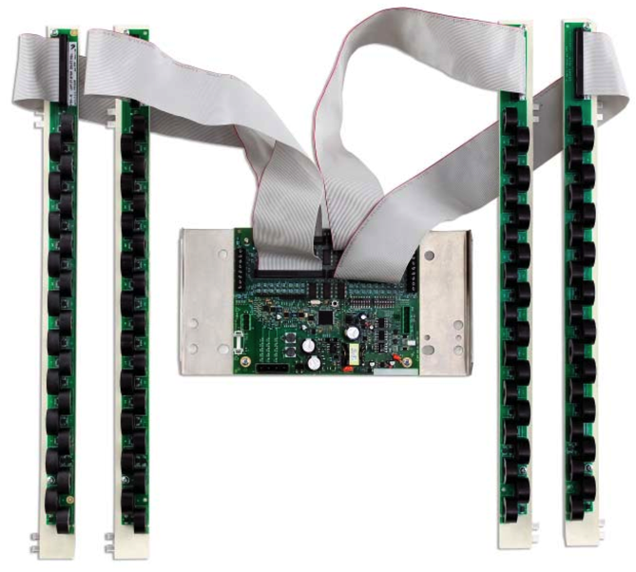
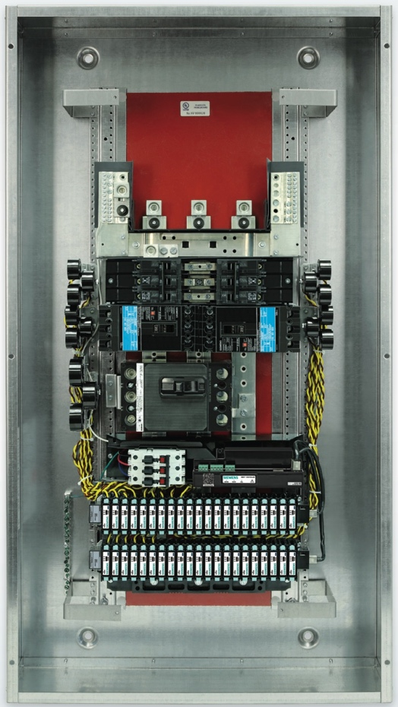

Existing commercial meters are expensive and hard to install
Circuits
Metering
Circuits
Installation complexity
Labor cost
Infrastructure upgrade
Meter cost
Easily >$1000
Highly accurate
Metering
Notes:
Explain the meters.

Slide 8
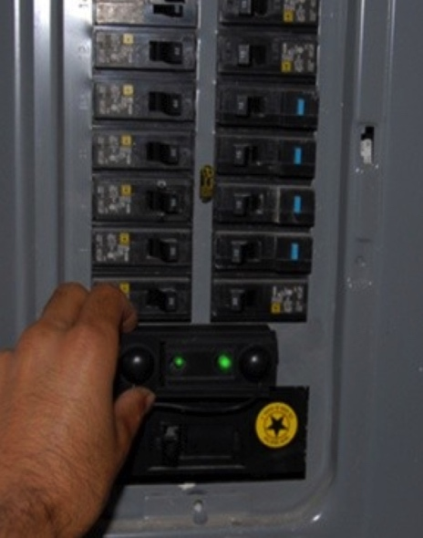
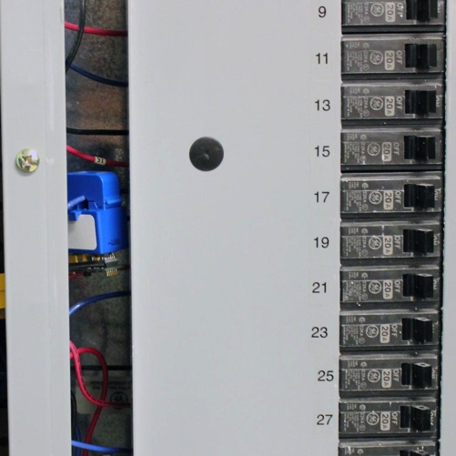
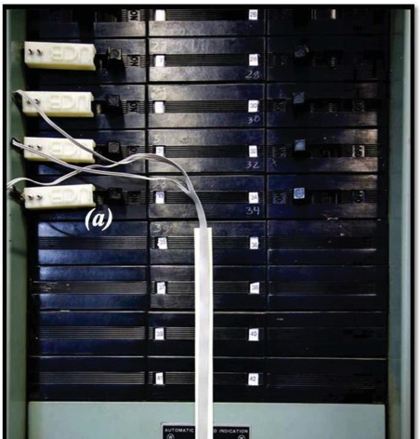
Research solutions address cost, installation, and size issues
Interference
Piezoelectromagnetic (PEM)²
Current Transformer Energy-Harvester (Monjolo)³
Magnetometer¹
Calibration and cross-talk issues
Not actually measuring true power
Accuracy issues
¹Patel, et. al, “The Design and Evaluation of an End-User-Deployable, Whole House, Contactless Power Consumption Sensor” CHI’10
²Xu, et. al, “Stick-On Piezoelectromagnetic AC Current Monitoring of Circuit Breaker Panels” Sensors’13
³DeBruin, et. al, “Monjolo: An Energy-Harvesting Energy Metering Architecture” SenSys’13
Notes:
Add citations. Again explain each device clearer. Add device type to monjolo. Swap pem and mag.

Slide 9
Not measuring true power leads to errors in non-unity power factor loads
Many loads have power factors < 1
Notes:
If you do not calculate true power . If not unity power factor, that is votlage and current arent sinusoids or are phase shifted then error high

Slide 10
We are missing the sweet spot of panel meter designs
Cost
Performance
`` | Install Cost | Unit Cost | Size | Online Calib. | Acc. | Cross Sensitivity | True Power | Update Rate
Commercial
Magnetometer
PEM
Monjolo
Clear cost vs. performance trade-offs
Notes:
Greener green

Slide 11
Panel power meter wishlist
Simple installation
Small devices – fit in existing panels
Retrofit
Low unit cost
DOE Wireless Metering Challenge: $100
Revenue grade accuracy not required
2-5% error is fine
No deployment-time calibration procedure
Notes:
Crisp description of reqs.

Slide 12
Gemini: energy-harvesting true power meter
Calculates true power by distributing current and voltage acquisition.
Virtualized Voltage
5 cm
Voltage Monitor
Current Meter
Non-contact
Calculates true power
Energy-harvesting
Notes:
Accurate relative timing is key
Overview image

Slide 13
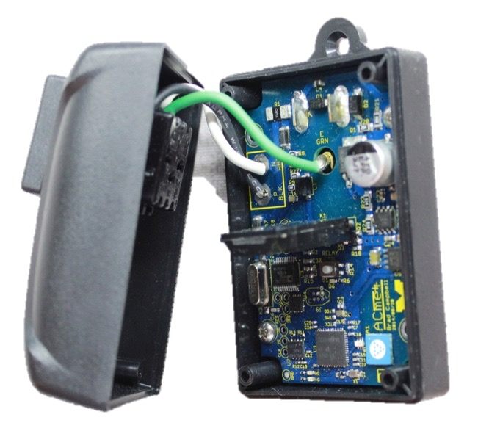
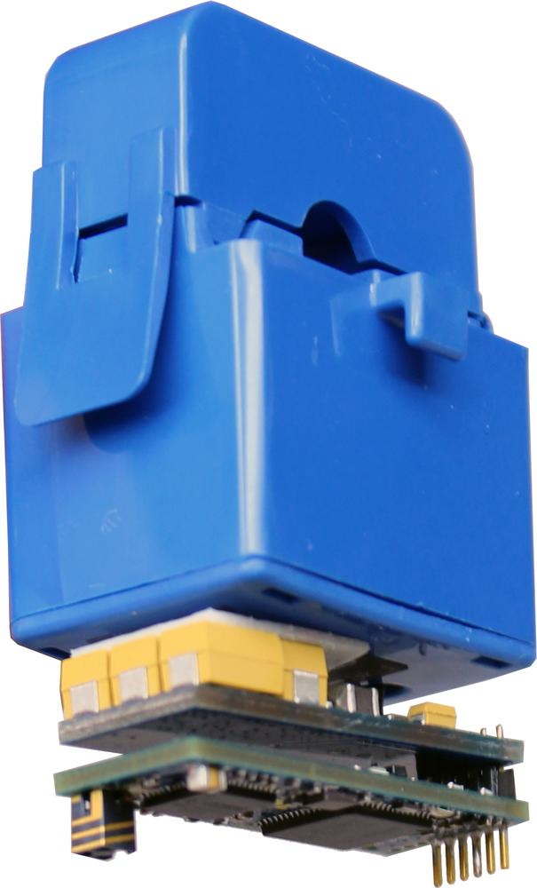
Virtualizing the voltage channel
A
φ
V_{AC}<A,φ>
Current Meter
Voltage Monitor
Many current sensors that synthesize the voltage channel locally
Few meters with access to voltage channel
Notes:
----- Meeting Notes (11/26/14 14:10) -----
compute reconstruction error for the

Slide 14
Voltage waveforms can be represented by one or a few Fourier Coefficients
Voltage
Current
Notes:
Harmonic distortion is much smaller on the voltage waveform than for the current waveform.
----- Meeting Notes (11/26/14 14:10) -----
compute reconstruction error for the

Slide 15
Key: properly phase-aligning the current and voltage waveforms
Voltage Monitor
Current Meter
V?
V?
Δt
Δt
A
A, Δt
SFD
SFD
Δt
A single packet provides time synchronization
Do not need time sync protocols

Slide 16
The current sensor’s energy-harvesting power supply limits its computational runtime
Duty cycle of 0.2% (load at 5 W)
1. Request Voltage
3 mJ
2. Sample Current
3. Receive Voltage
2
4
1
3
5
4. Calculate Power
5. Store Result
Notes:
Add labels between lines and events

Slide 17
Results: average error 8.7%, average absolute error: 2.2 W
Gemini
Ground Truth
Percent Error

Slide 18
Timing errors between voltage and current have large effects on error
Notes:
Explain expirement better. Artificially introduce error. Highlight points.
Combining values measured at distinct locations is not necessarily new, but timing matters here (sub ms)

Slide 19
The effect of measuring voltage at a different location is minimal
Impedance of the loads:
Voltage triangle:
V_{L}=I•Z_{L}
Calculate phase offset:
V=I•Z
φ
1.7° (0.08 ms) voltage phase difference between the two loads
V_{R}=I•R
Notes:
3% error for fridge
30 meters of 14 gauge wire = 0.25 ohms

Slide 20
Approximating voltage with a single Fourier coefficient results in less than 2% error
Power calculation error using synthesized voltage

Slide 21
The current sensor must use the correct voltage channel in its calculations
Buildings typically have three phase power (three voltage channels offset by 120°).
How does the sensor choose the correct voltage channel?
Correct
±180°
120°
240°
Heuristic: Try all three voltage phases and choose the largest value.
Notes:
Automatic mapping removes the need for human configuration – which is wrong sometimes
Question: how do we know which is the correct voltage phase?

Slide 22
Revisiting the matrix of panel meter designs
`` | Install Cost | Unit Cost | Size | Online Calib. | Acc. | Cross Sensitivity | True Power | Update Rate
CT Based
Magnetometer
PEM
Monjolo
Gemini |  |  |  |  |  |  |  | Load Proportional
Gemini Limitations
Sample rate
Possibility: add a single daisy chained wire for power to each current transformer
Detecting broken nodes
When load is off harvesting stops and updates stop
Possibly look at historical trends to distinguish

Slide 23
Gemini is an accurate true power meter
Installable
Small, independent current transformers
Accurate
Virtualized voltage allows for sample-by-sample power calculations

Slide 24

Questions?
Brad Campbell
bradjc@umich.edu
http://bradcampbell.com
http://lab11.eecs.umich.edu
University of Michigan

Slide 25
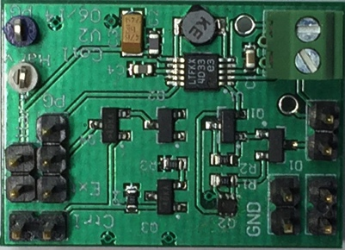
Power meter design
Energy-harvesting power supply
Measurement and communication
Uses multiple Current Transformers
For harvesting and measurement
Working on a design for multiplexing a single
Notes:
Label as current meter. Break down and explain the pieces. Green box could be replaced by wires or battery.

Slide 26
Cost

